Slide 1
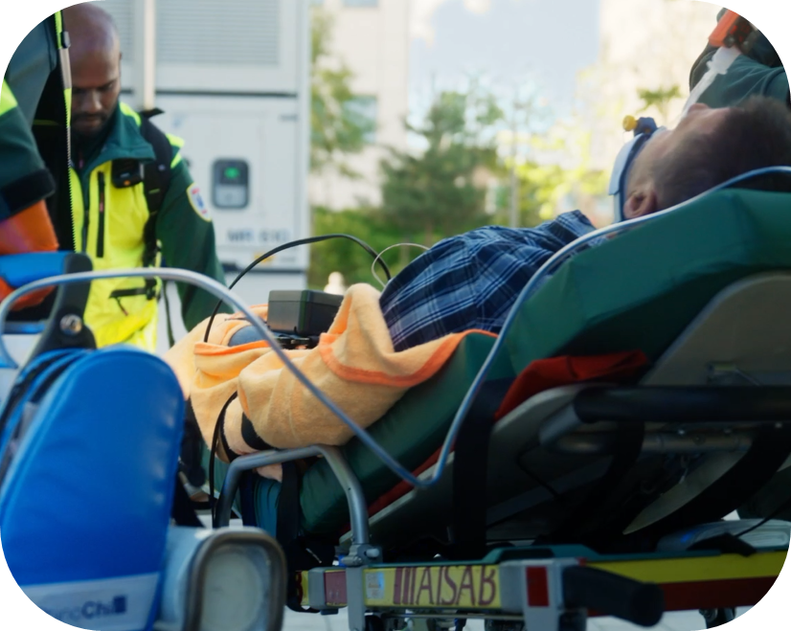
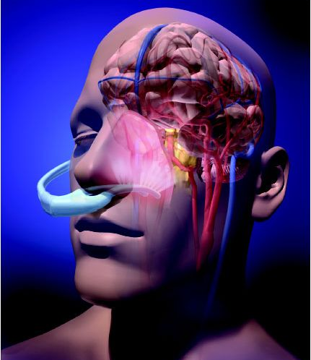
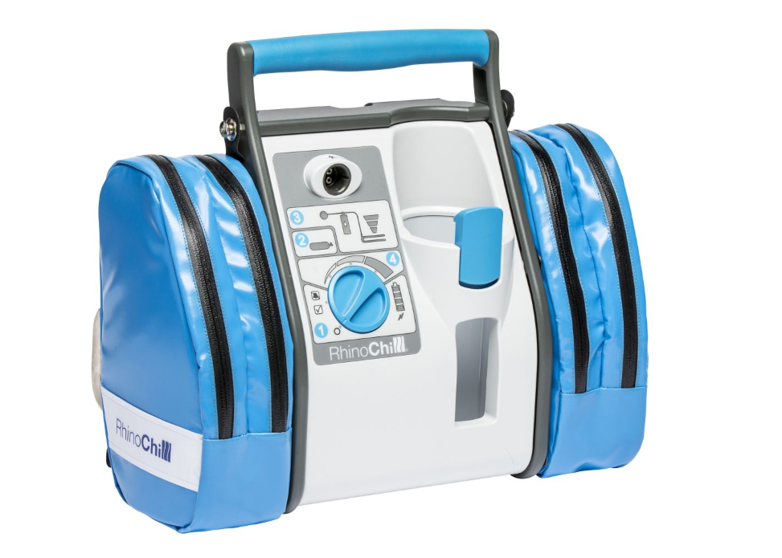
An international trial investigating the impact of early initiated hypothermia in OHCA patients with initial shockable rhythm, on neurologic recovery.
OHCA
with initial shockable rhythm
Intervention
Trans-nasal cooling initiated during ACLS followed by systemic hypothermia to 33ºC for 24 h
Control
Standard ACLS followed by normothermia with fever control for 72 h
Scene of arrest
Intervention
Prehospital trans-nasal cooling
Control
Standard ACLS
Hospital arrival
Trans-nasal cooling
until start of systemic cooling
All patients
Sedation 40 h
EEG within 72 h (patients not completely awake)
Neurologic prognostication at 72 h
Systemic cooling
33°C for 24 h
Rewarm 0,25°C/h
Fever control
until 72 h from cardiac arrest
Fever control
Until 72 h from cardiac arrest
Neurologic prognostication at 72 h
Primary outcome
Full neurologic recovery
(mRS 0-1) at 90 days
Site Investigator: Name
Film
Website
Any questions, please contact:
Name
Email adress
Phone number
Name
Email adress
Phone number
Name
Email adress
Phone number

